Slide 1
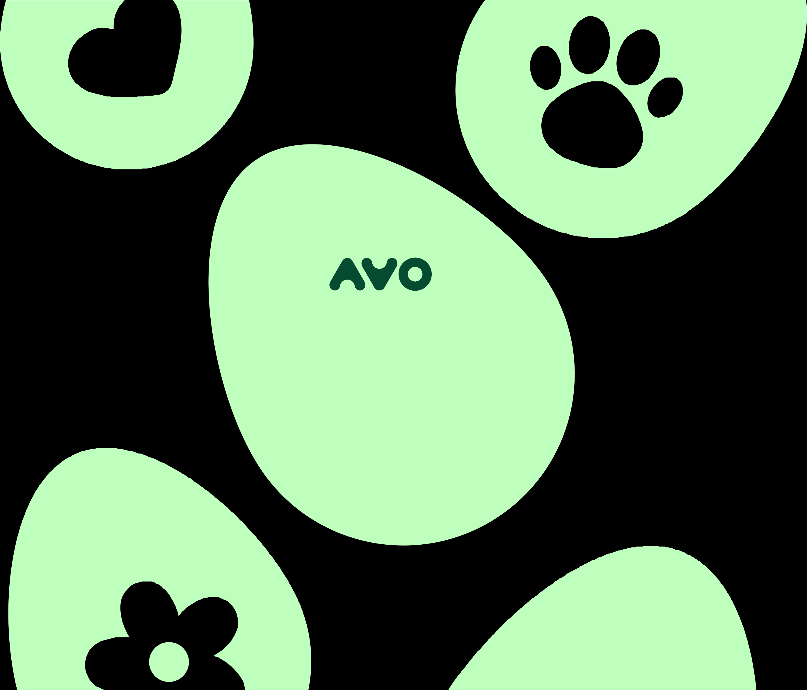
Brand Guidelines
2021

Slide 2
The purpose of this brand book is to define the core guidelines of Avo’s brand identity in order to maintain a uniform and consistent visual display among all parties working on the brand.
Observing these guidelines will ensure a consistent and coherent message — a key factor in building powerful brands. The design scheme in this
brand book reflects Avo’s brand positioning, personality, and values. Through visual and communicative language, the implementation of these guidelines will help enhance the brand image in the eyes of potential clients, consumers, and employees.

Slide 3
Strategy
Chapter 01

Slide 4

Strategy
Positioning Vision Core Idea Values
Tone and Voice Overview Guidelines Applications
What You Need – Everyday
The no fee, no minimum, no hassle delivery of your everyday needs and wants
Brand Guidelines

Slide 5

Today, science tells us that people’s happiness depends on their ability to be mindful of small, tangible, reachable delights.
Strategy
Positioning Vision Core Idea Values
Tone and Voice Overview Guidelines Applications
We are revolutionizing the world of e-commerce to make that a possibility for everyone, everyday: to re-ignite the joy of the small recurring things and get delight within your routine.
Brand Guidelines

Slide 6

Strategy
Positioning Vision Core Idea Values
Tone and Voice Overview Guidelines Applications
Everyday Delight
Brand Guidelines

Slide 7

Strategy
Positioning Vision Core Idea Values
Tone and Voice Overview Guidelines Applications
Convenience | Satisfaction Joy | Routine Presence
Brand Guidelines

Slide 8

Casual, Familiar, A little Surprising, Full of Joy
Strategy
Positioning Vision Core Idea Values
Tone and Voice
Overview
Language Components
Applications
A character that you meet everyday within your routine – at work or at home – that sparks a small and familiar sense of joy.
A little “yay!” every day.
Brand Guidelines

Slide 9
Overview
Chapter 02

Slide 10

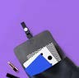

Brand Guidelines
10 | 41
Strategy
Overview
Brand Elements
Examples
Guidelines
The Avo brand identity is composed of six brand
elements:
The logo, our main element;
the symbol, that derives from the logo; the colors;
the typography and
our illustrations;
the photographic language
Logo
Symbol
A AA
אאא
Typography
Colors
Photography
Illustration

Slide 11
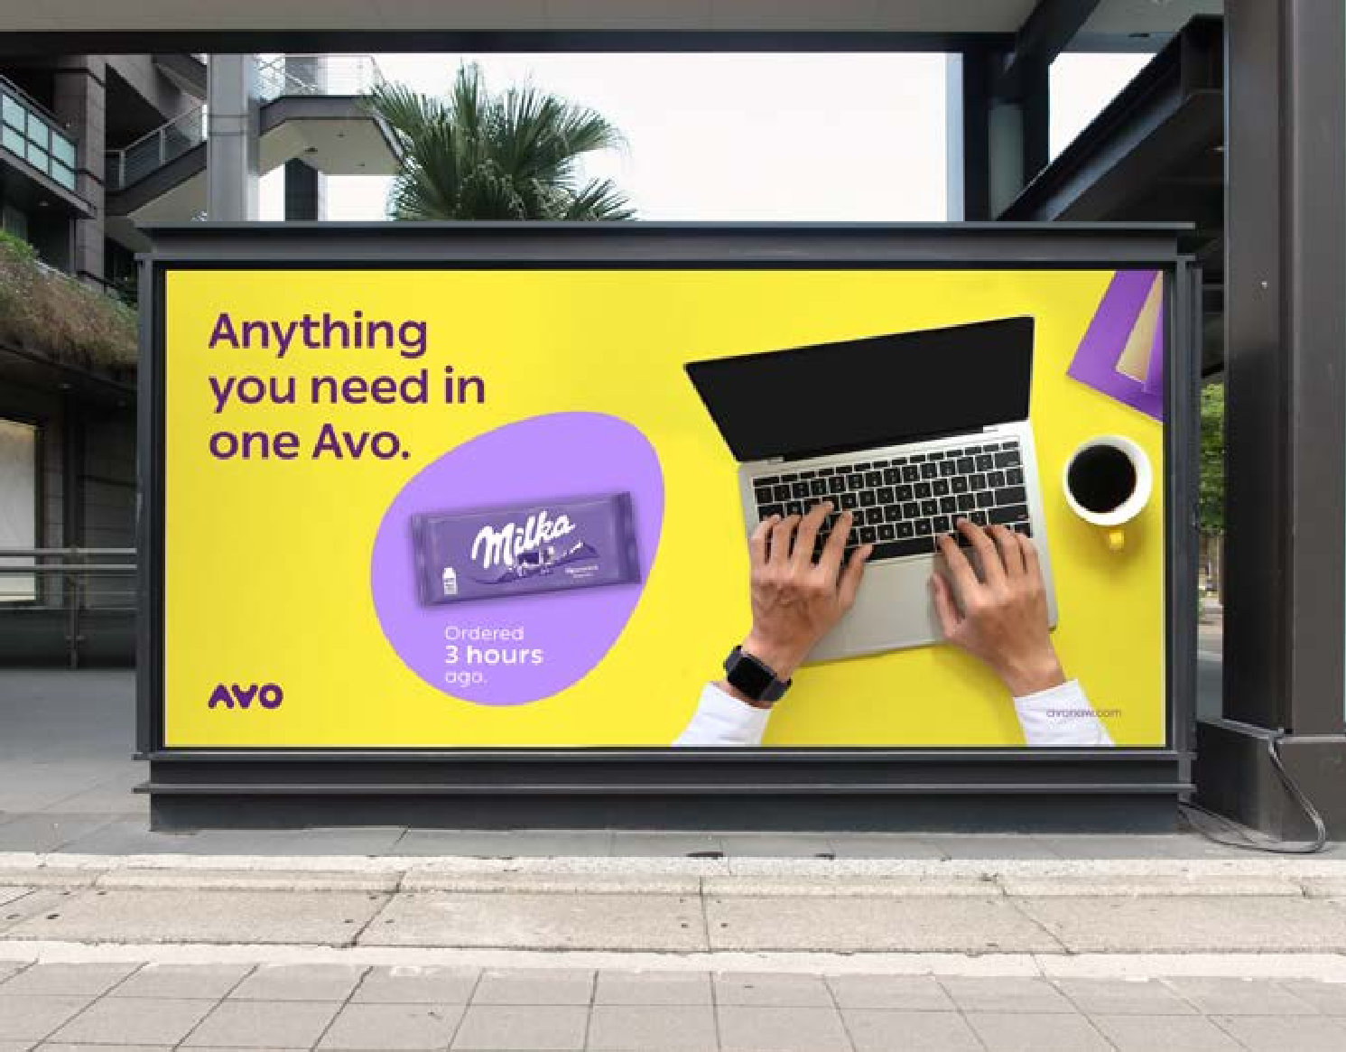
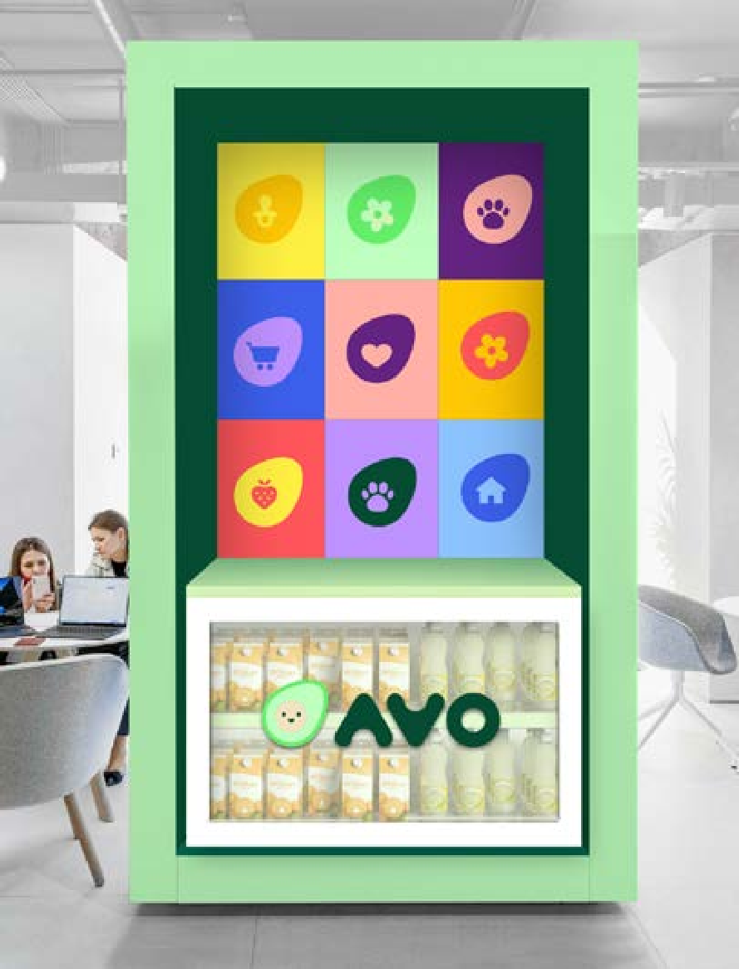
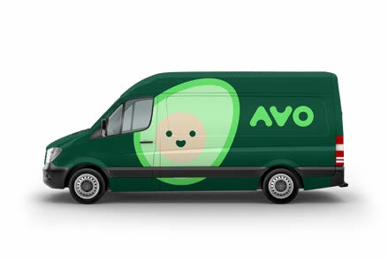
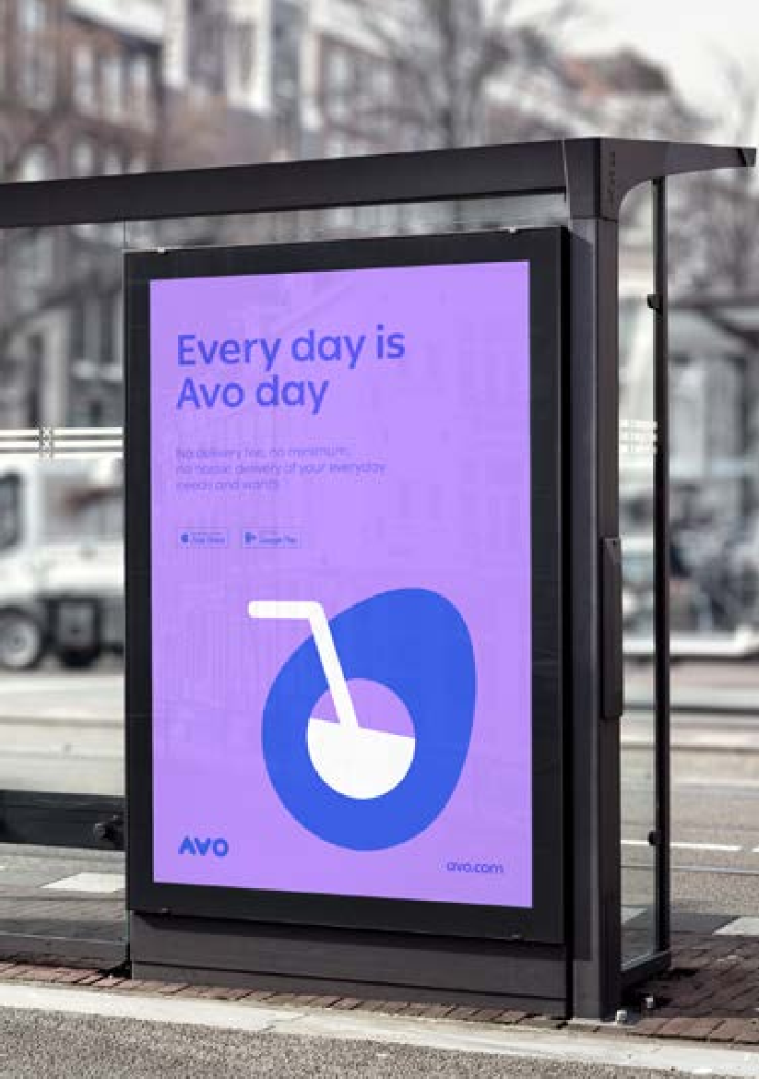
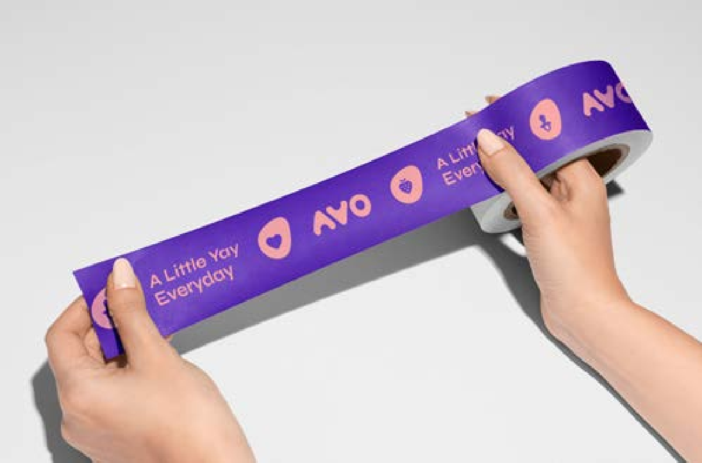
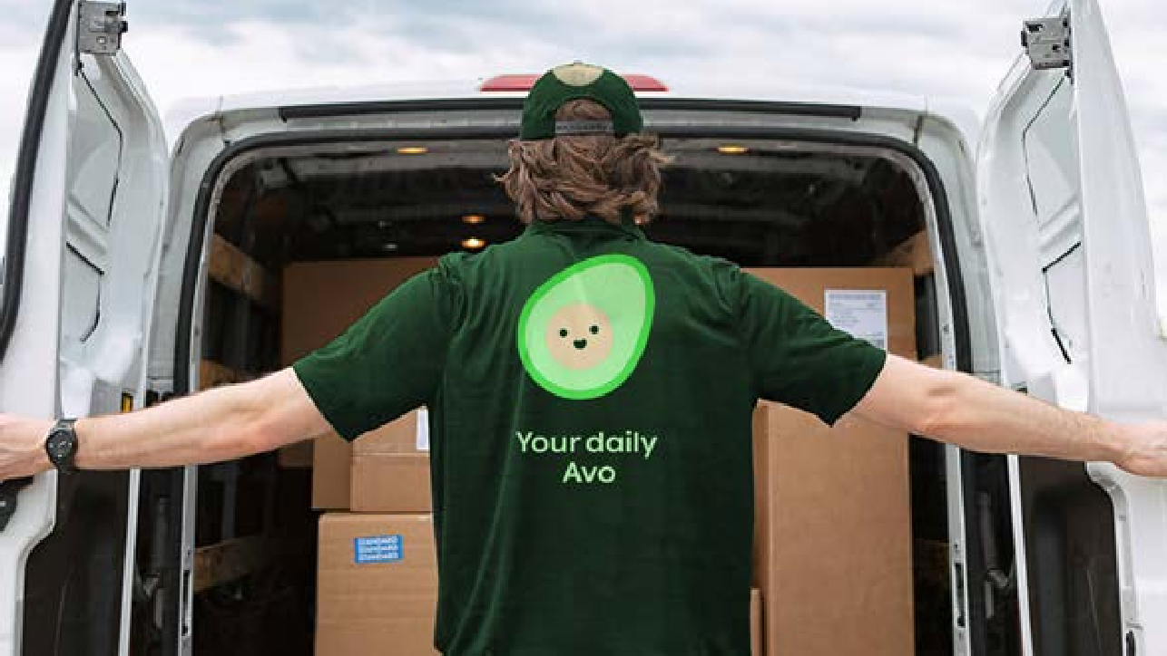
Brand Guidelines
11 | 41
Strategy
Overview
Brand Elements
Examples Guidelines Applications

Slide 12
Guidelines
Chapter 03

Slide 13
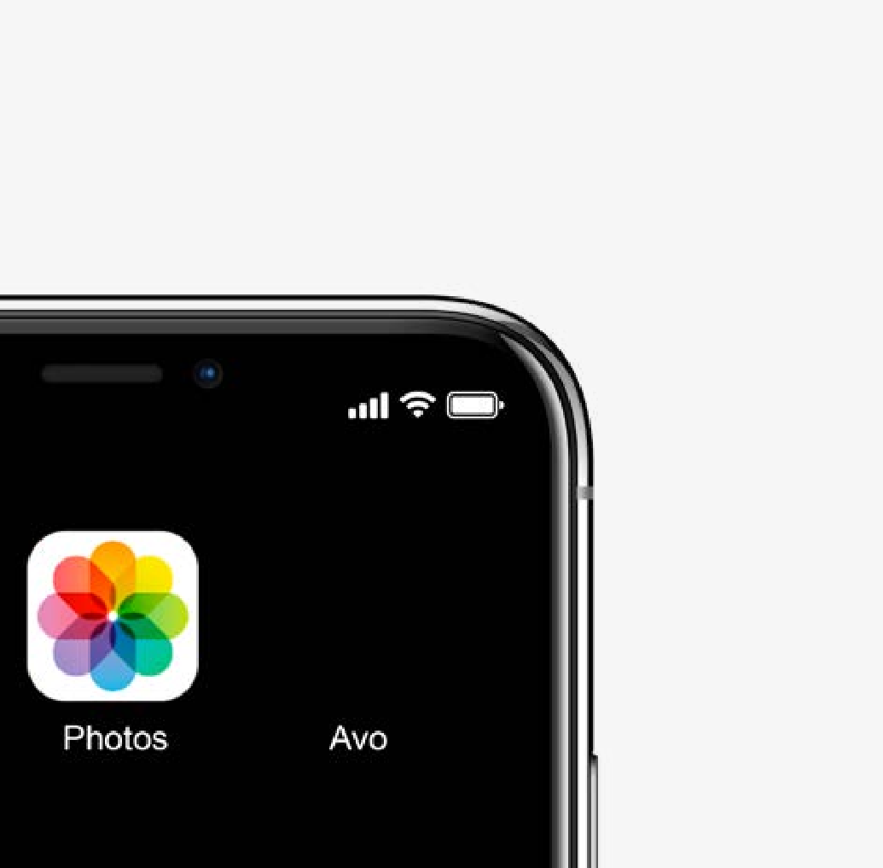
Brand Guidelines
13 | 41
Strategy
Overview Guidelines Logo Versions Logo Clearspace Symbol Minimum Size Positioning Prohibited Uses Typography Colors Illustration Icons Photography Grid Applications
Logo Versions
Main Logo
The main logo has to appear on every representative application.
Logotype
We use the logotype for applications with a colored background. You can use it in every color of the brand.
Symbol
The logo symbol is mainly used for App icons or social media avatars, like Facebook and Instagram.

Slide 14
Brand Guidelines
14 | 41
Strategy
Overview Guidelines Logo Versions Logo Clearspace Symbol Minimum Size Positioning Prohibited Uses Typography Colors Illustration Icons Photography Grid Applications
Main Logo
The Avo logo is one of our most important tools to sign our brand. Our logo needs to be used appropriately, consistently, and in a way that protects it. It appears on all communications and products.
The main logo is just allowed on bright background only. Please use the negative version for dark pictures or backgrounds.
Never use this logo on a colored background!
Please only use the approved digital files of the original artwork.
Symbol
Logotype
Logo
Negativ version for dark backgrounds

Slide 15
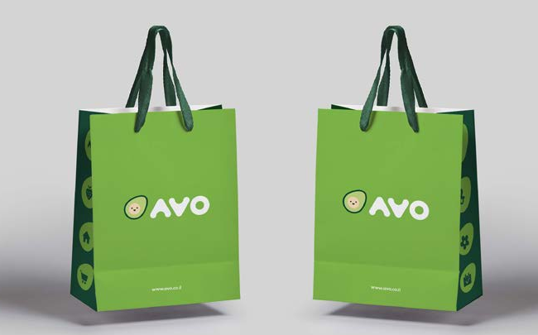
Brand Guidelines
15 | 41
Strategy
Overview Guidelines Logo Versions Logo Clearspace Symbol Minimum Size Positioning Prohibited Uses Typography Colors Illustration Icons Photography Grid Applications
Special Use
We chose an alternative option for the logo that should only be used in specific applications such as the shopping bags (see right).
Only when the main green is used as a background color, this alternative logo version is appropriate to be used.
Alternative Logo on Main Green Background

Slide 16
Brand Guidelines
16 | 41
Strategy
Overview Guidelines Logo Versions Logo Clearspace Symbol Minimum Size Positioning Prohibited Uses Typography Colors Illustration Icons Photography Grid
Clearspace
In order to preserve the integrity of our logotype, it is important that no other logo, type, or graphic elements infringe on
its space. To measure the clear space around our logotype we choose to use the size of the letter "O".
O
O
Applications

Slide 17
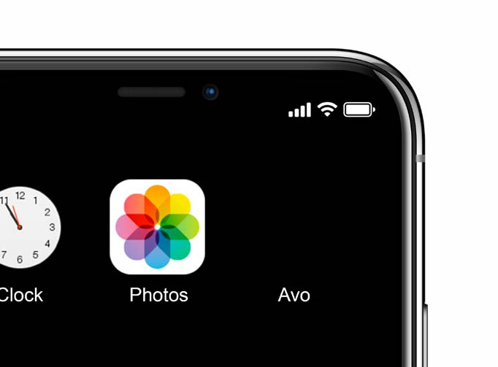

Brand Guidelines
17 | 41
Strategy
Overview Guidelines Logo Versions Logo Clearspace Symbol Minimum Size Positioning Prohibited Uses Typography Colors Illustration Icons Photography
Symbol
To represent our brand in a small space we choose our avocado as an icon for social media and the app.
Use half the size of the face as a reference for the clearspace.
Please only use the approved digital files of the original artwork.
App Icon
Linkedin
Facebook
Grid
Applications

Slide 18
Brand Guidelines
18 | 41
Strategy
Overview Guidelines Logo Versions Logo Clearspace Symbol Minimum Size Positioning Prohibited Uses Typography Colors Illustration Icons Photography
Minimum Size
The minimum size is the smallest size our logo can appear.
Be sure to use the correct artwork of our logo; avoid using any undersized logos.
Main Logo
55 px
8 mm
Logotype
30 px
4 mm
Symbol
55 px
8 mm
Grid
Applications

Slide 19
Brand Guidelines
19 | 41
Strategy
Overview Guidelines Logo Versions Logo Clearspace Symbol Minimum Size Positioning Prohibited Uses Typography Colors Illustration Icons Photography
Positioning
The logo should always be placed for maximum legibility. Therefore you can place the logo in each corner of the application.
Size
The priority is the legibility of the the logo. Nevertheless, here you find a list of recommended logo sizes for print formats.
Recommended logo height: A4 10 mm
A3 15 mm
A2 20 mm
A1 30 mm | A2 20 mm
 | A3 15 mm | A4 10 mm
Grid
Applications
A1
30 mm

Slide 20
Brand Guidelines
20 | 41
01
02
Strategy
Overview Guidelines Logo Versions Logo Clearspace Symbol Minimum Size Positioning Prohibited Uses Typography Colors Illustration Icons Photography
Positioning
Don't change the gap between the symbol and the logotype
Don't change the proportions between the symbol and the logotype
Don't use other colors for the
03
04
symbol
4. Don't use an icon as a symbol next to the logo
Don't rearrange the logo
Don't use the main logo on a colored background
05
06
Grid
Applications

Slide 21
_{Ab}Brand Guidelines _{cde}21 | 41
Strategy
Overview Guidelines Logo Versions Logo Clearspace Symbol Minimum Size Positioning Prohibited Uses Typography Colors Illustration Icons Photography Grid Applications
English Font
For messages in English, we use the font "Ping" in different weights.
Always typeset it with optical kerning and set the tracking to 0. You can download the font and the license here
Ping - Bold
ABCDEFGHIJKLMNOPQRSTUVWXYZ
abcdefghijklmnopqrstuvwxyz
Ping - Medium
ABCDEFGHIJKLMNOPQRSTUVWXYZ
abcdefghijklmnopqrstuvwxyz
Ping - Regular
ABCDEFGHIJKLMNOPQRSTUVWXYZ
abcdefghijklmnopqrstuvwxyz
Ping - Light
ABCDEFGHIJKLMNOPQRSTUVWXYZ
abcdefghijklmnopqrstuvwxyz

Slide 22
_{תשרק}Brand Guidelines 22 | 41
Strategy
Overview Guidelines Logo Versions Logo Clearspace Symbol Minimum Size Positioning Prohibited Uses Typography Colors Illustration Icons Photography Grid Applications
Hebrew Font
For messages in Hebrew, we use the font "Ping" in different weights.
Always typeset it with optical kerning and set the tracking to 0. You can download the font and the license here
Ping - Bold
תשרקץצףפעסןנםמלכיטחזוהדגבא
1234567890^₪*)(=-%!@#$!@
Ping - Medium
תשרקץצףפעסןנםמלכיטחזוהדגבא 1234567890^₪*)(=-%!@#$!@
Ping - Regular
תשרקץצףפעסןנםמלכיטחזוהדגבא 1234567890^₪*)(=-%!@#$!@
Ping - Light
תשרקץצףפעסןנםמלכיטחזוהדגבא 1234567890^₪*)(=-%!@#$!@

Slide 23
Abcde
Brand Guidelines 23 | 41
Strategy
Overview Guidelines Logo Versions Logo Clearspace Symbol Minimum Size Positioning Prohibited Uses Typography Colors Illustration Icons Photography Grid Applications
System Font
Please use "Arial" as our system font for applications like Powerpoint, Email Signatures and Word Documents.
Arial - Bold
ABCDEFGHIJKLMNOPQRSTUVWXYZ
abcdefghijklmnopqrstuvwxyz
תשרקץצףפעסןנםמלכיטחזוהדגבא 1234567890^₪*)(=-%!@#$!@
Arial - Regular
ABCDEFGHIJKLMNOPQRSTUVWXYZ
abcdefghijklmnopqrstuvwxyz
תשרקץצףפעסןנםמלכיטחזוהדגבא 1234567890^₪*)(=-%!@#$!@

Slide 24
Brand Guidelines
24 | 41
Strategy
Overview Guidelines Logo Versions Logo Clearspace Symbol Minimum Size Positioning Prohibited Uses Typography Colors Illustration Icons Photography Grid Applications
Ideal Stack
The exact point sizes and leading are not prescriptive and should be adapted to the size of the materials and layouts for which they're being designed.
However, the general proportions, weights, and notes on kerning and tracking should be kept intact for all layouts.
Headline
Ping - Bold
Everyday is Avo day!
No delivery fee, no minimum,
no hassle delivery of your everyday needs and wants.
Big Text
Ping - Light
Small Headline
Ping - Bold
Bodycopy
Ping - Regular
Avo is everything you wish for
Et fugia sinum nobitibus mintion nobis dic tem invenis ut ea dipsa doluptur sus moluptatio. Nam reperum nihilluptas ipicate susae nihitat empore sam, cum reperna tquatiur sim nos restiae storro ea dolorro excepro evenis magnime essint quuntis ratur simi, es andi dolorumquis est autem. Et fugia sinum nobitibus mintion nobis dic tem invenis ut
ea dipsa doluptur sus moluptatio. Nam reperum nihilluptas ipicate susae nihitat empore sam, cum reperna tquatiur sim nos restiae storro ea dolorro excepro evenis magnime essint quuntis ratur simi, es andi dolorumquis sim nos restiae storro ea dolorro excepro evenis magnime essint quuntis ratur simi, es andi dolorumquis

Slide 25
Brand Guidelines
25 | 41
Strategy
Overview Guidelines Logo Versions Logo Clearspace Symbol Minimum Size Positioning Prohibited Uses Typography Colors Illustration Icons Photography Grid Applications
Primary Color
We choose a fresh green as our main color. Make sure that this color is seen as that and appears in representative applications
Our brand-colors should be used consistently across different media. The correct color values are specified on this page. Make sure to use them.
RGB HEX
CMYK
Pantone
100/240/105
#64f069
55/0/85/0
375C
Avo Green

Slide 26
Brand Guidelines
26 | 41
Strategy
Overview Guidelines Logo Versions Logo Clearspace Symbol Minimum Size Positioning Prohibited Uses Typography Colors Illustration Icons Photography Grid Applications
Secondary Colors
Our brand-colors should be used
consistently across different
media. The correct color values
are specified on this page. Make
sure to use them.
RGB 100/35/130 #642382
CMYK
70/90/0/0
RGB
190/145/255
#be91ff
CMYK
35/50/0/0
RGB 5/75/50 #054b32
CMYK
85/40/75/40
RGB
190/255/190
#beffbe
CMYK
30/0/60/0
RGB
255/200/5
#ffc805
CMYK
0/55/95/0
RGB
255/240/65
#fff041
CMYK
0/20/100/0
RGB
255/85/90
#ff555a
CMYK
0/95/70/0
RGB
255/175/165
#ffafa5
CMYK
0/40/25/0
RGB
60/95/235
#3c5feb
CMYK
100/70/0/0
RGB
140/195/255
#8cc3ff
CMYK
55/20/0/0

Slide 27

Brand Guidelines
27 | 41
Strategy
Overview Guidelines Logo Versions Logo Clearspace Symbol Minimum Size Positioning Prohibited Uses Typography Colors Illustration Icons Photography Grid Applications
Print Colors
In print, colors can never appear in the same vibrant way as they show on screens.
On the right, we show an example of how the colors will (apprximately) appear in print.
Digital (RGB or HEX)
Print (CMYK or Pantone)

Slide 28




Brand Guidelines
28 | 41
Strategy
Overview Guidelines Logo Versions Logo Clearspace Symbol Minimum Size Positioning Prohibited Uses Typography Colors Illustration Icons Photography Grid Applications
Color Combination
To make it easy for you we decided on the best color combinations shown on this page. But there are many more!
Before you combine new colors, please check out the next page of "Color Misuses".

Slide 29
Brand Guidelines
29 | 41
Strategy
Overview Guidelines Logo Versions Logo Clearspace Symbol Minimum Size Positioning Prohibited Uses Typography Colors Illustration
Color Misuse
In consideration of legibility and aesthetics, we recommend not to use this combination.
Icons
Photography Grid Applications

Slide 30
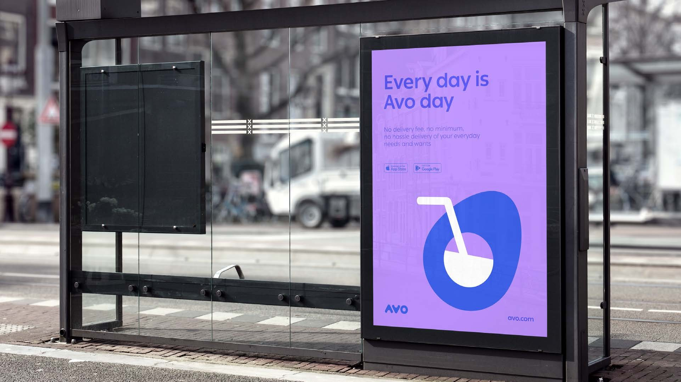
Strategy Overview Guidelines Logo Versions Logo Clearspace Symbol Minimum Size Positioning Prohibited Uses Typography Colors Illustration
Illustration
You can do many more things with an avocado than just eat it. We for example use our avocados to express
the ton of voice.
Brand Guidelines
30 | 41
Icons
Photography Grid Applications

Slide 31


Brand Guidelines
31 | 41
Strategy
Overview Guidelines Logo Versions Logo Clearspace Symbol Minimum Size Positioning Prohibited Uses Typography Colors Illustration
Illustration
Use our illustration to tell stories or just for a little "yay" on your application.
Make sure to use only two colors on one illustration and keep
in mind which colors can be combined.
Icons
Photography Grid Applications

Slide 32


Brand Guidelines
32 | 41
Strategy
Overview Guidelines Logo Versions Logo Clearspace Symbol Minimum Size Positioning Prohibited Uses Typography Colors Illustration Icons Photography Grid Applications
Icons
Our icons are as colorful as our branding. Replace the seed of the avocado with any item you can imagine.
Keep a small distance between the icon in the center and the edge of the avocado.

Slide 33


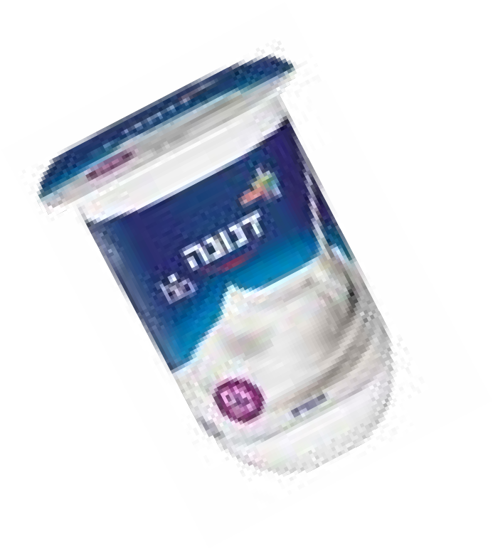



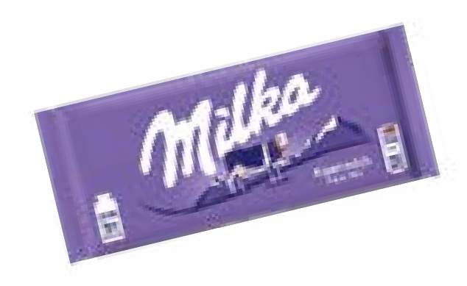



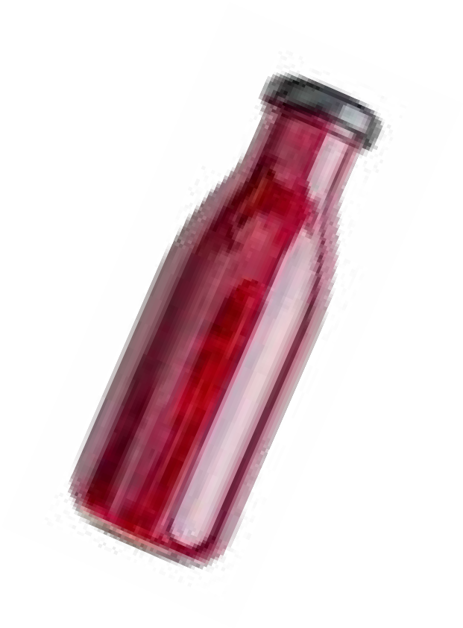



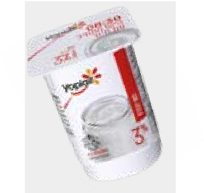
Brand Guidelines
33 | 41
Strategy
Overview Guidelines Logo Versions Logo Clearspace Symbol Minimum Size Positioning Prohibited Uses Typography Colors Illustration Icons
Photography
Our photography should tell stories, show how we live our daily life and how Avo provides us with a little “yay!”.
The setup is a typical desk at the office, photographed
from above. The background is colored in one of the brand colors.
Photography
Grid
Applications

Slide 34
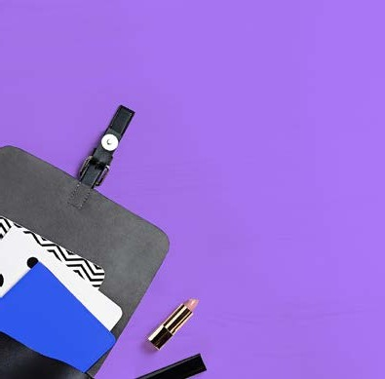

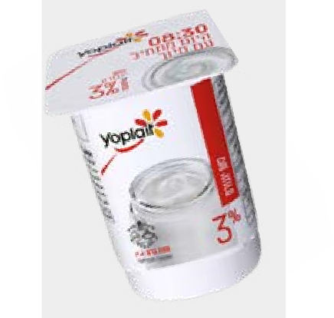

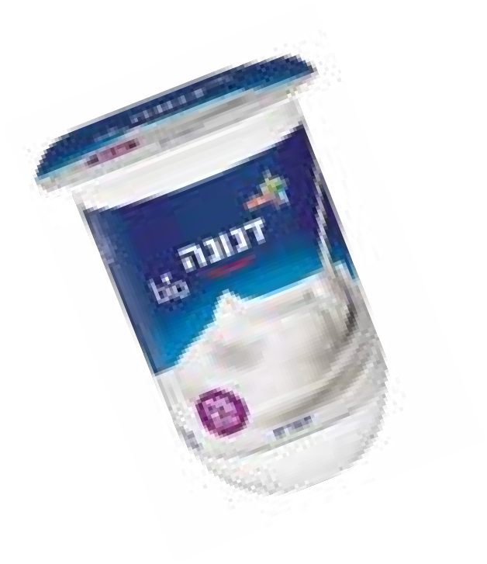
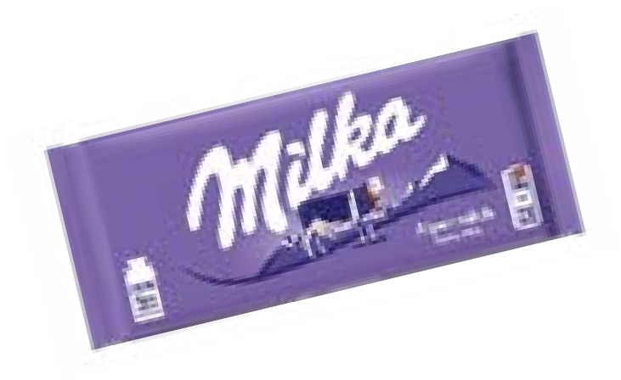
Avo is everything you wish for
Brand Guidelines
34 | 41
Strategy
Overview Guidelines Logo Versions Logo Clearspace Symbol Minimum Size Positioning Prohibited Uses Typography Colors Illustration Icons
Product Photography
We don't deliver just any item, we deliver a little "yay".
And this is how it should look like.
No delivery fee, no minimum, no hassle delivery of your everyday needs and wants.
Ordered
3 hours
Our products are always laying with a small shadow on the ground.
ago.
Add a little note to show how fast we delivered it. Highlight the time with a thicker font-weight
Ping - Regular / Bold
To emphasize the product, we put underneath an avocado shape. It should have almost the size of the item itself.
Examples
Photography
Grid
Applications

Slide 35


Brand Guidelines
35 | 41
Strategy
Overview Guidelines Logo Versions Logo Clearspace Symbol Minimum Size Positioning Prohibited Uses Typography Colors Illustration Icons Photography
Save Zone
The safe zones are free areas for you to put your message on.
In this area, the background should be free of elements and has a high contrast to the typography
Alignment
Because we are dealing with two different kinds of languages make sure that you align every language the right way. Hebrew to the right and English to the left.
Everyday is Avo day
No delivery fee, no minimum,
no hassle delivery of your everyday needs and wants.
המ לכ שבקל ךלש Avo-לש
תוא ופמו הטילכותש הארשה תוצקב ור ןכותה תא לכותה קשמ יב רופוח ופדה בא ןיב טרוא לשב םייתרזעבצא תוציע
Grid
Applications
Ailgn to the left
Ailgn to the right

Slide 36





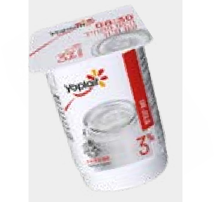

Brand Guidelines
36 | 41
Strategy
Overview Guidelines Logo Versions Logo Clearspace Symbol Minimum Size Positioning Prohibited Uses Typography Colors Illustration Icons Photography Grid Applications
Margin for digital banner
Banners use fixed margins of 30px. However, if the height/ width ratio is more than 1:4 and the size of the banner is very small, margins could be smaller.
 | Everyday is Avo day No delivery fee, no minimum, no hassle delivery of your everyday needs and wants. avonow.com
Banner 800x250px / 30px (Margin)
Margin for print
Margins are defined by the letter O of the logo.
In print we have a margin of 1,5 O.
Recommended logo height: A4 10 mm
A3 15 mm
A2 20 mm
A1 30 mm
 | Avo is everything you wish for No delivery fee, no minimum, no hassle delivery of your everyday needs and wants. Ordered 3 hours ago.
1,5 O
1,5 O

Slide 37
Applications
Chapter 04

Slide 38

Brand Guidelines
38 | 41
Strategy
Overview Guidelines Applications Car
Uniform Pickup Station Website
Tape

Slide 39
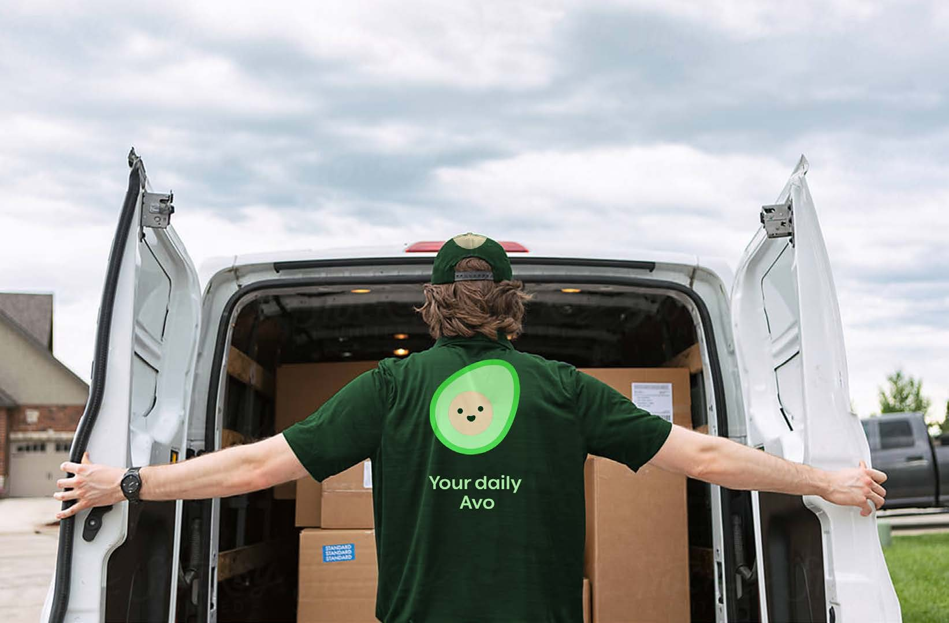
Brand Guidelines
39 | 41
Strategy
Overview Guidelines Applications Car
Uniform Pickup Station Website
Tape

Slide 40
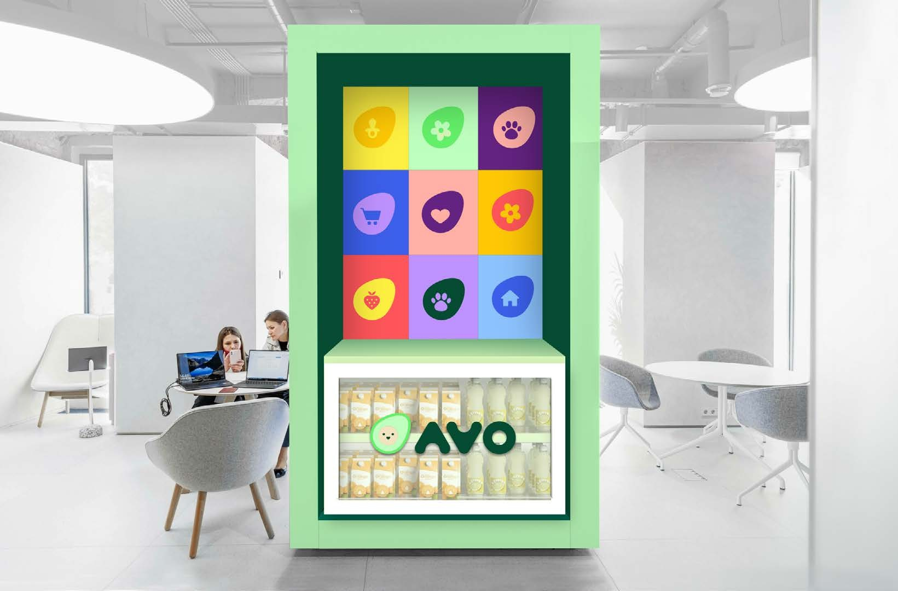
Brand Guidelines
40 | 41
Strategy
Overview Guidelines Applications Car
Uniform Pickup Station Website
Tape

Slide 41
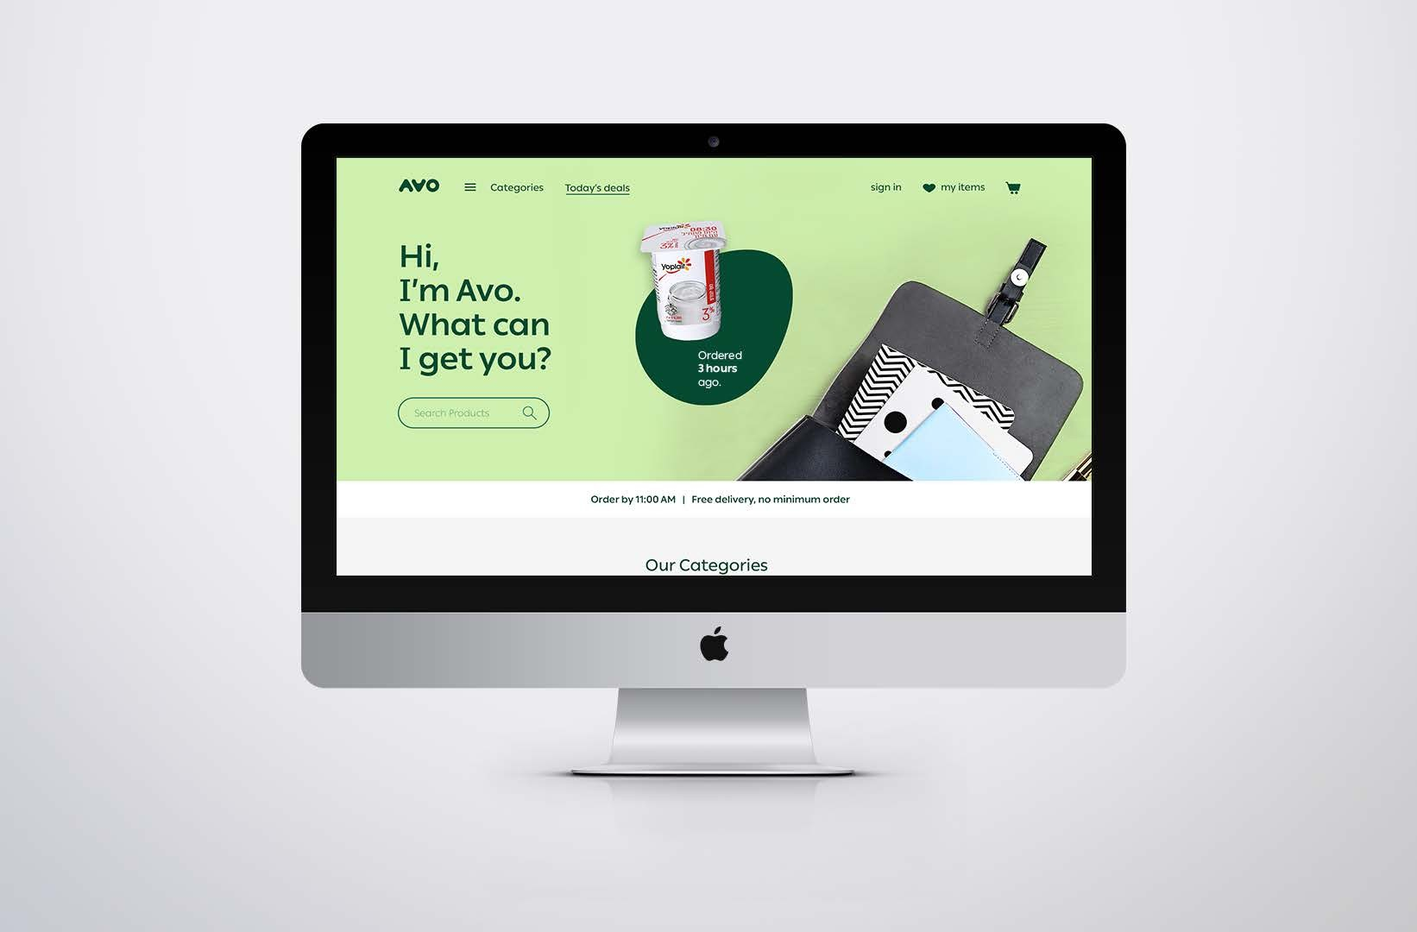
Brand Guidelines
41 | 41
Strategy
Overview Guidelines Applications Car
Uniform Pickup Station Website
Tape

Slide 42
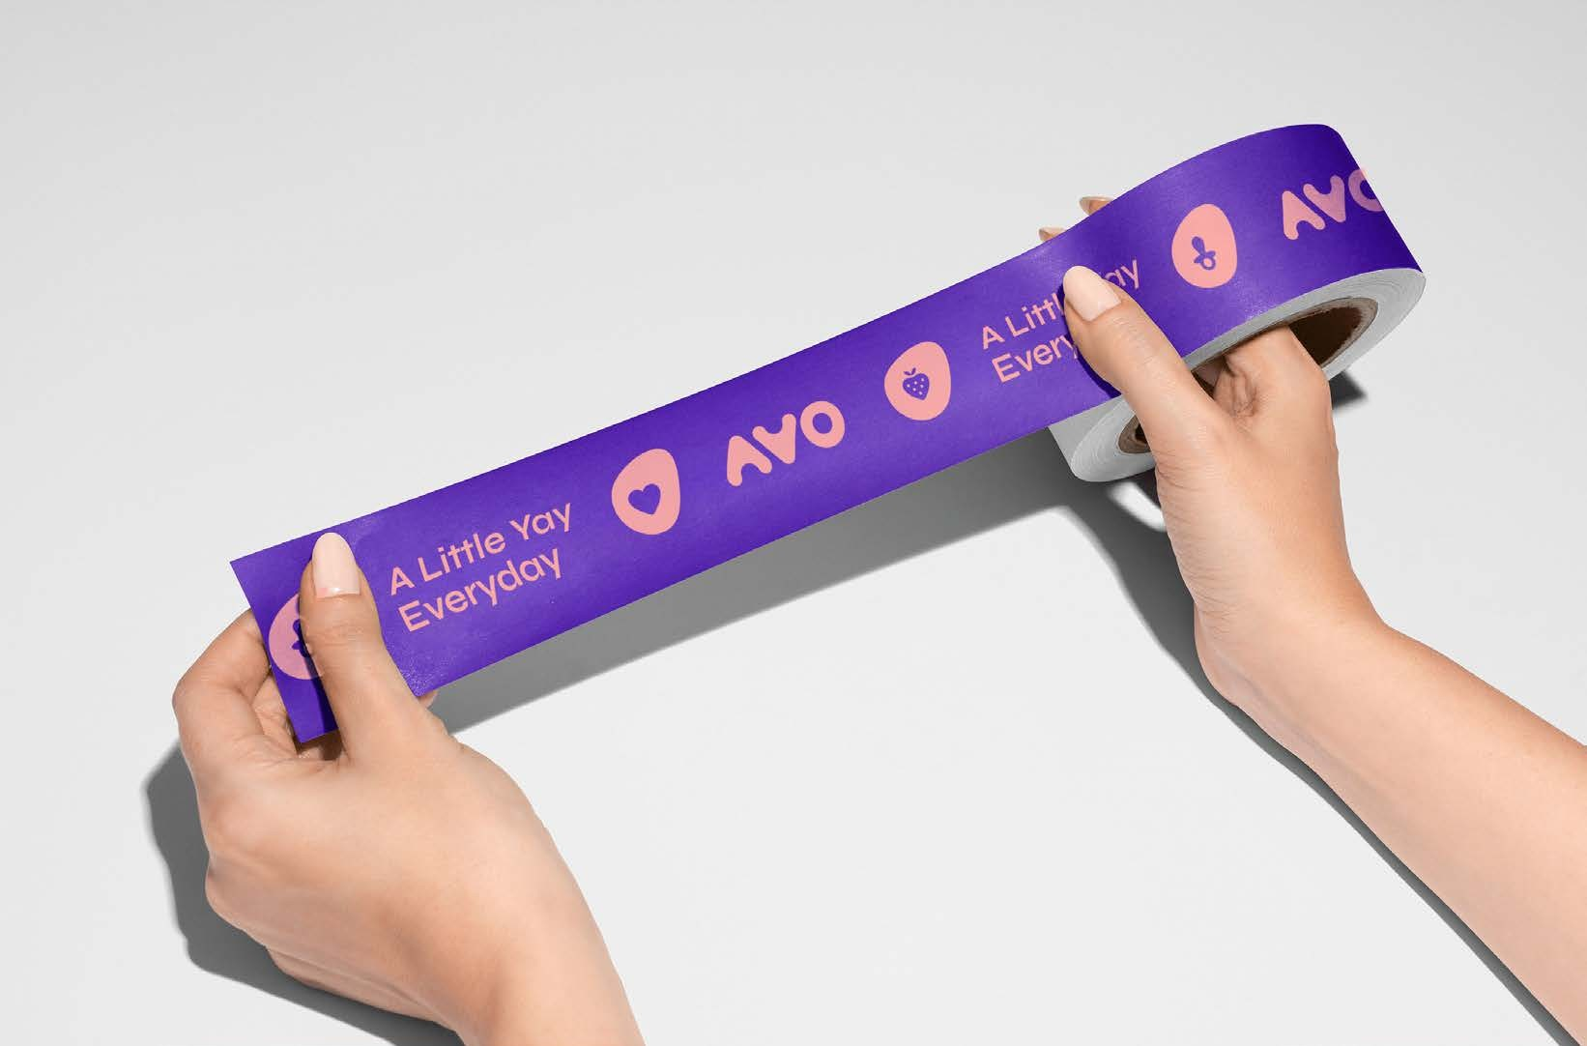
Brand Guidelines
42 | 41
Strategy
Overview Guidelines Applications Car
Uniform Pickup Station Website
Tape

Slide 43
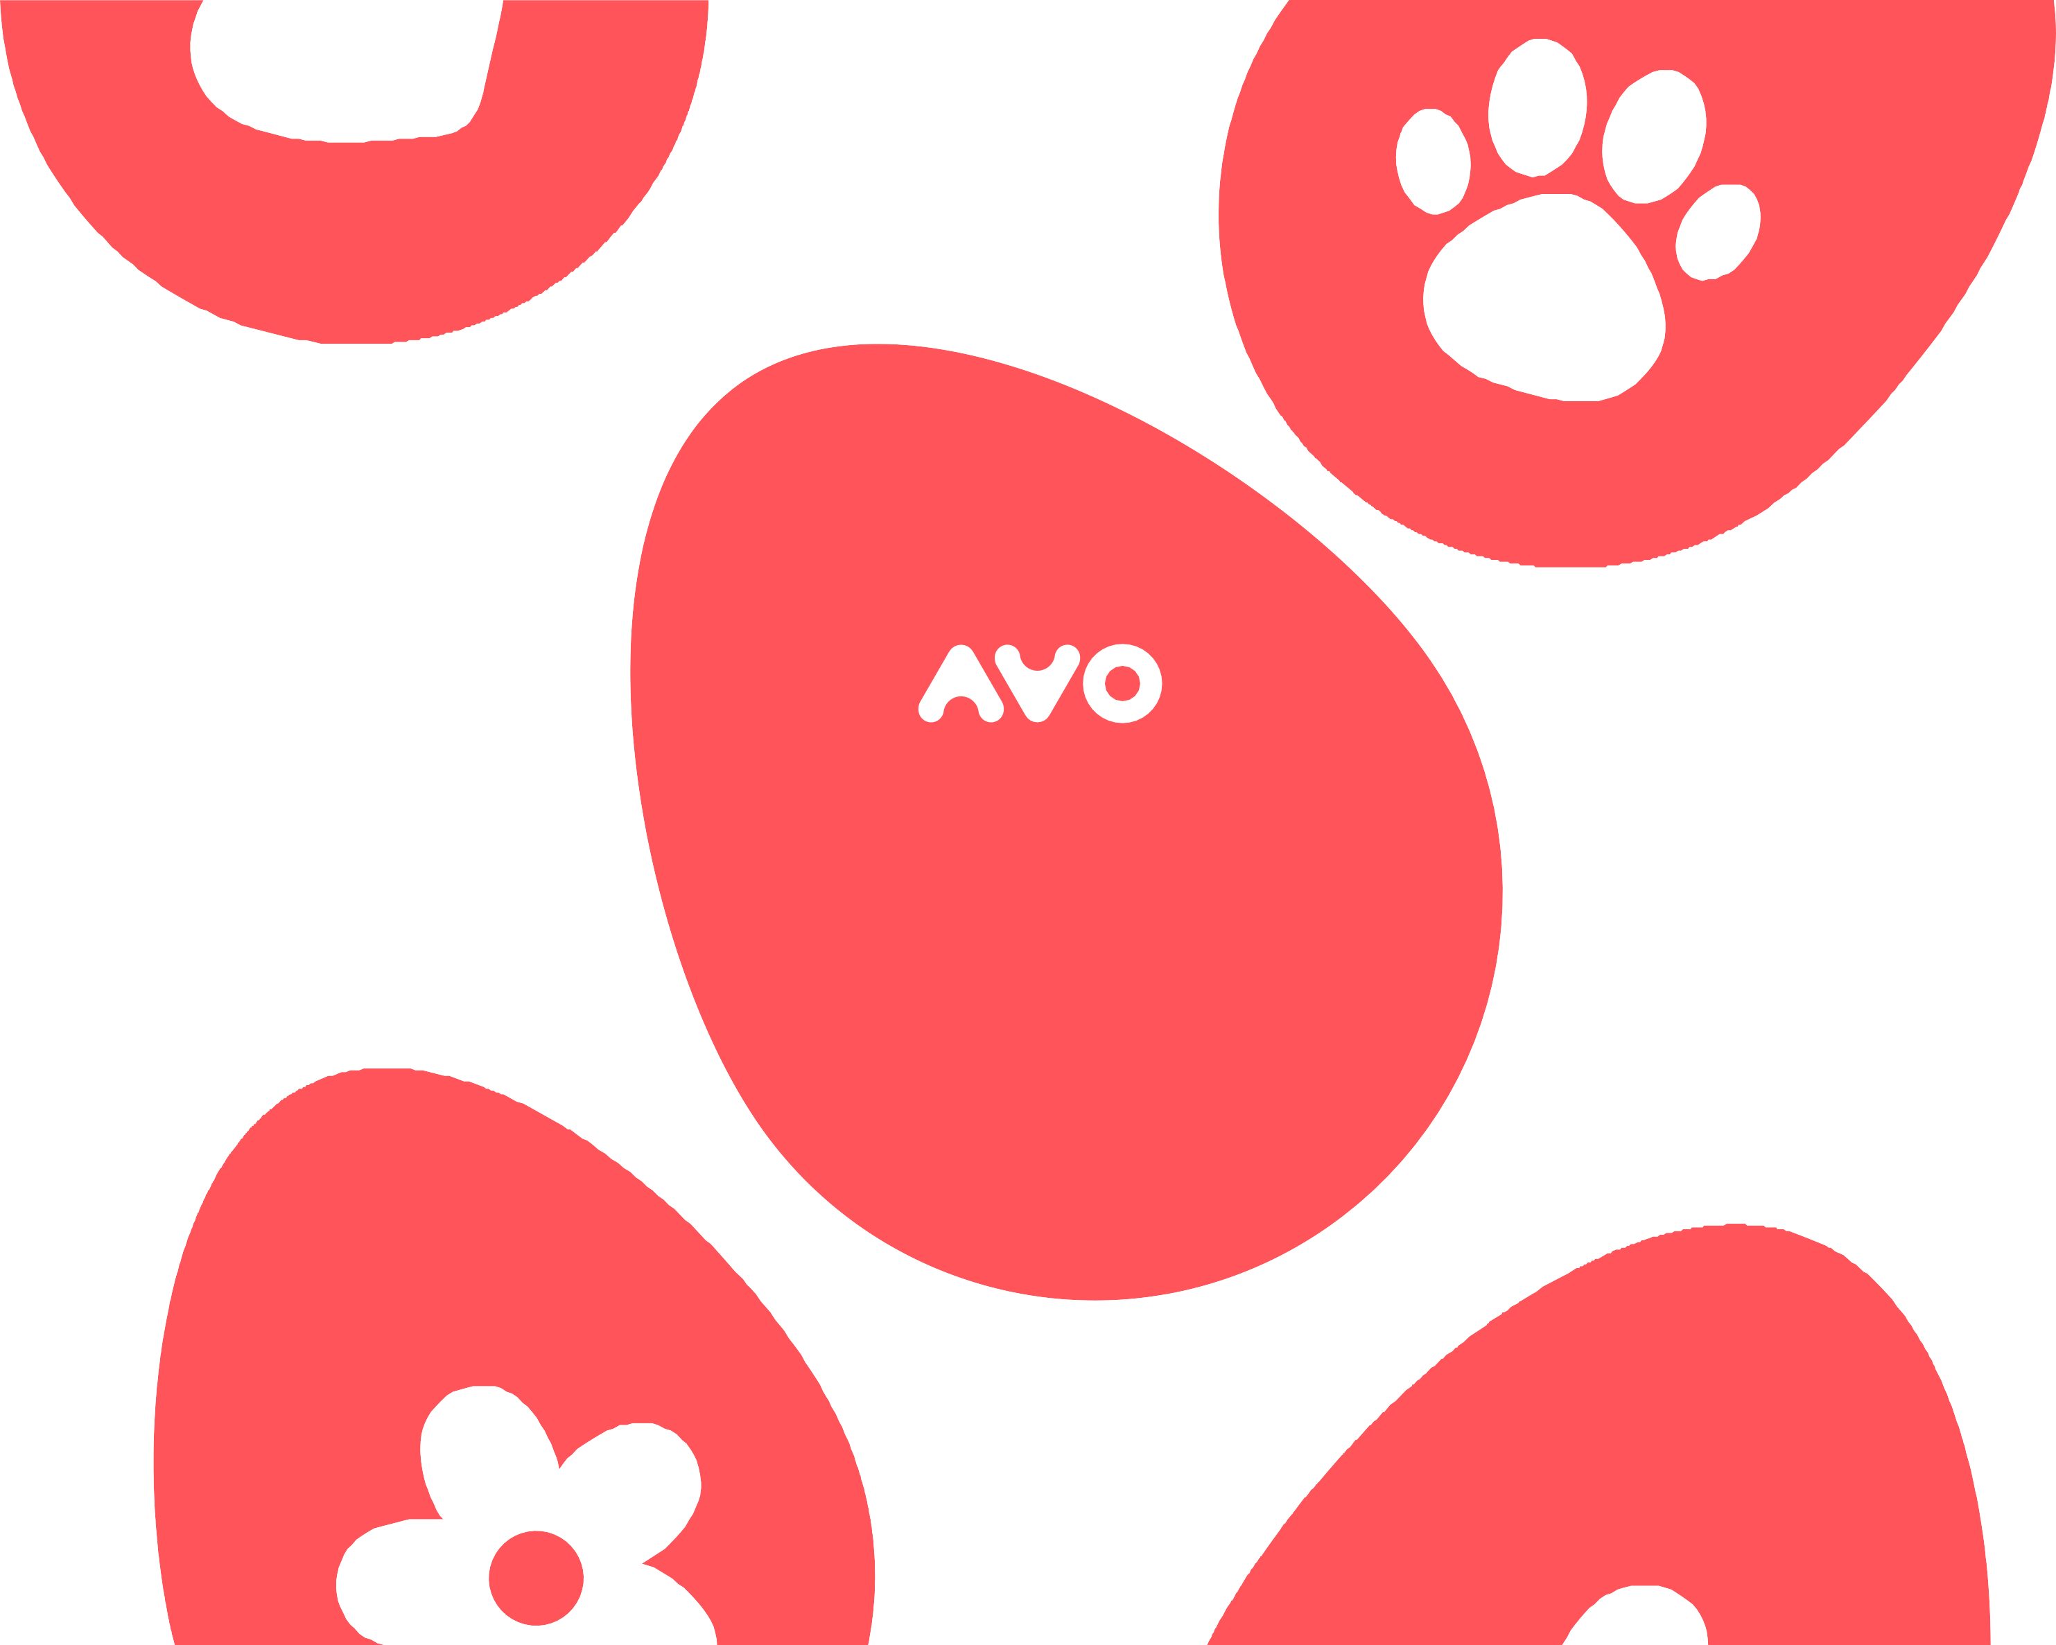
Let's spread joy!

